Slide 1
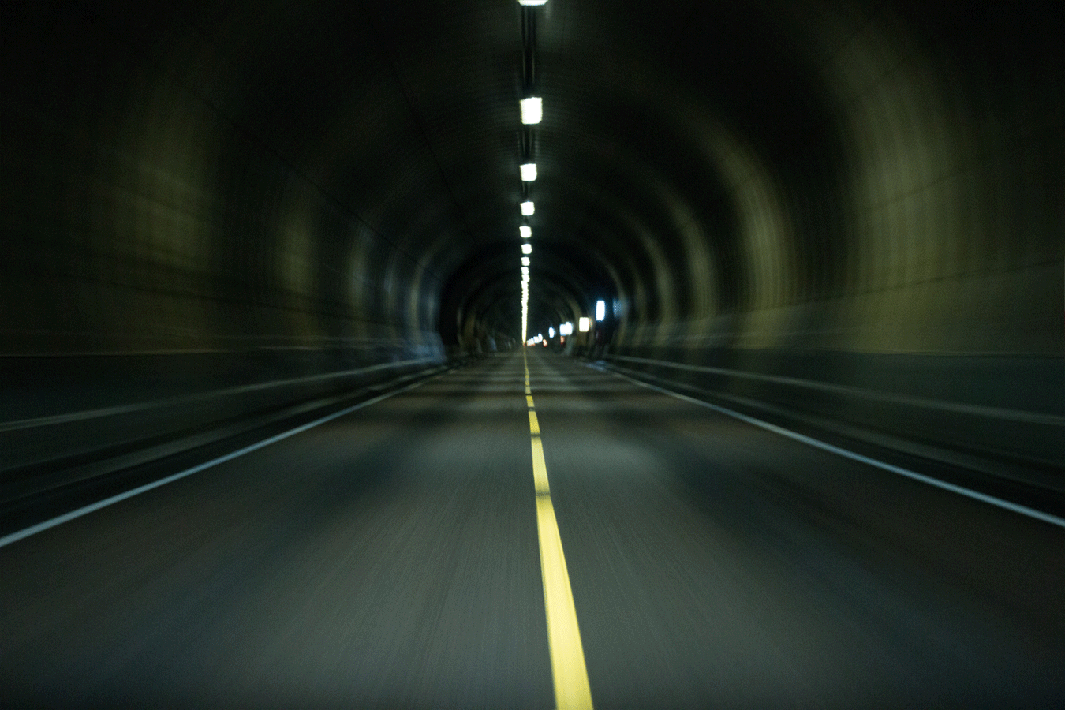
ROAD LANE LINE DETECTION
PRESENTED BY-
P.SRI HARI

Slide 2
CONTENT
ABSTRACT
INTRODUCTION
DATASET
METHODOLOGY
RESULT
CONCLUSION

Slide 3
ABSTRACT
Driver assistance systems are one of the most significant features of contemporary automobiles for ensuring driver safety and reducing vehicle accidents on the road.
The recognition of road lanes or road borders appears to be the most intricate and difficult assignment.
It comprises road localization and determining the relative position of the vehicle and the road .
This project describes a vision system that uses an on-board camera to view out the windshield.
The system acquires the front image of the car using a camera installed on the vehicle and determines the lanes using a few procedures. The lanes are retrieved using the Hough transform.

Slide 4
INTRODUCTION
Road detection played a significant part in driving assistance systems, providing information such as lane structure and vehicle location relative to the lane.
This project provides a vision-based technique capable of recognizing and monitoring structured road borders (painted lane lines) with modest curvature and shadow circumstances in real time.
After performing edge detection and the Hough transform, road borders are recognized. The car should go on a level, straight route or one with a gradual curve.

Slide 5
DATASET
The dataset picked for this project consists of three photographs and three films that were made public on GitHub. These media files are ideal for this project since they were collected by a car dashboard camera.
Images from dataset are classified as -
1. white lane line image
2. Left side yellow lane line image
3. Right side yellow lane line image
4. Curved road lane line image
5. Left side yellow lane curved road image
Videos from dataset are classified as –
1. Curved road lane line
2. Left side yellow lane line
3. Right side yellow lane line

Slide 6
METHODOLOGY
Image Capturing
Filtering by Colour
Region of Interest
Canny Edge Detection
Hough Line Detection
Overlay Detected Lane
Applying to Video

Slide 7
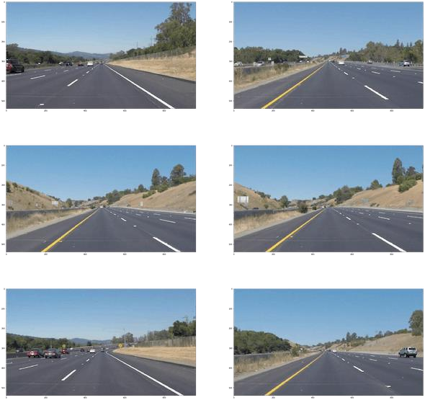

IMAGE CAPTURING
The photographs were collected in real time (up to 30 frames per second) by the on-board computer with image capturing card and kept in the computer memory.
The lane detecting system began processing after reading the picture sequences from memory.

Slide 8
FILTERING BY COLOR
Lane lines aren't commonly green, blue, or brown. They are often white or golden in hue.
Color filtering in RGB or BGR color spaces, on the other hand, is too complex. We may simply filter out superfluous colors by using multiple color spaces, or color representations.
The HLS color space, which stands for Hue, Lightness, and Saturation, is one such color space that makes color filtering extremely simple.
To obtain the yellow lane lines, we will remove any pixels with a Hue value between 10 and 50 and a high Saturation value.
To create the white lane lines, we'll remove any pixels with a Lightness value of less than 190.

Slide 9
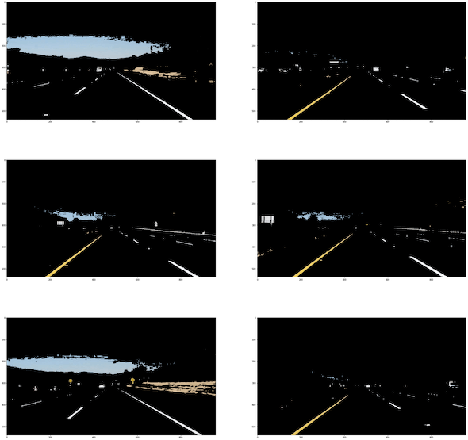
FILTERED IMAGES

Slide 10
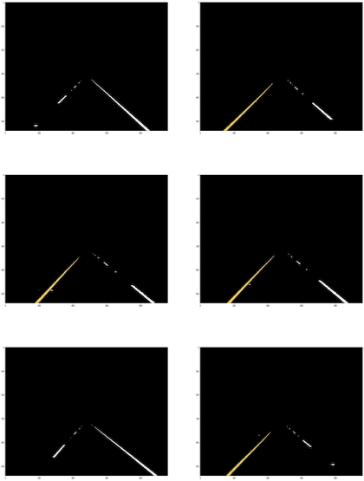
REGION OF INTEREST
By blocking off a region of interest, we can limit down where we're looking for lane lines.

Slide 11
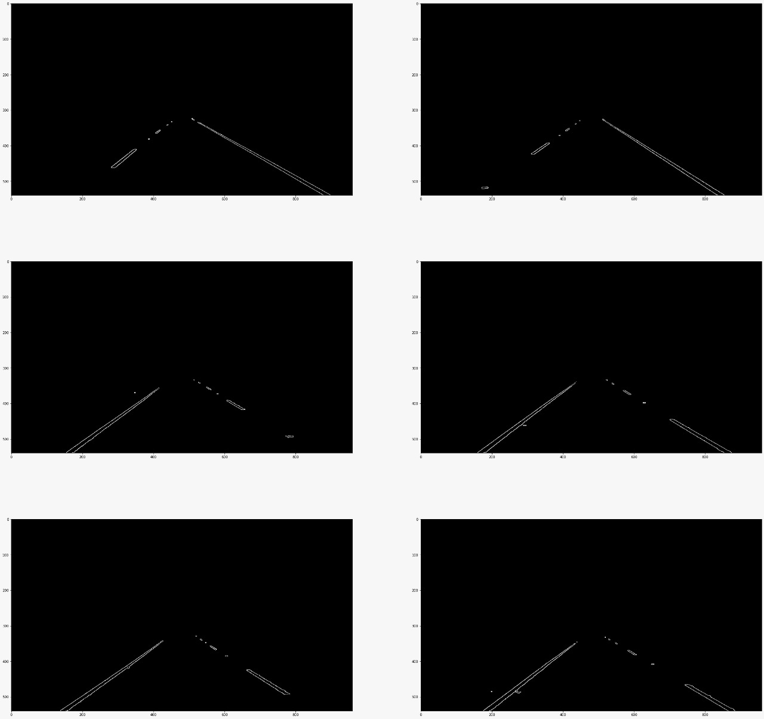
CANNY EDGE DETECTION
This is simple to accomplish with Canny Edge Detection. Canny Edge Detection works on the assumption that pixels near edges have a strong gradient, or rate of change in value.
We can take advantage of this and utilize it to detect lane lines.

Slide 12
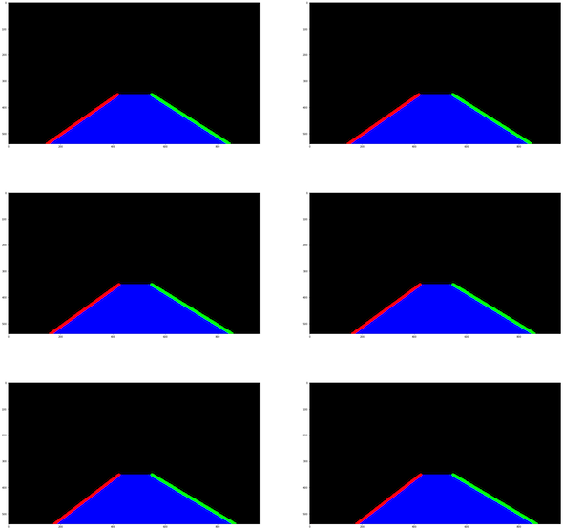
Hough Line Detection
We need to find the lane lines using the previously discovered canny edges.
We'll compute the lines using cv2.HoughLinesP() and then filter out the lines.
We'll start by deleting lines that aren't inside a certain slope range or position.
we will filter the lines into their respective lanes based on whether the filtered lines have a positive or negative slope.

Slide 13
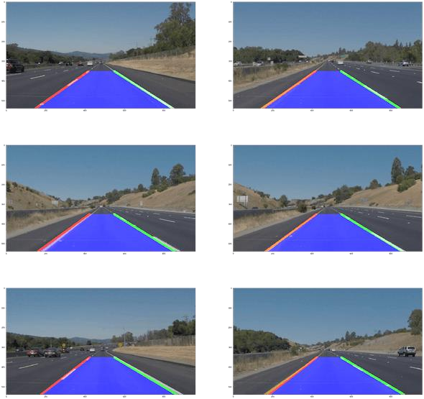
OVERLAY DETECTED LANE
We may now include the previously discovered lanes into the original picture.

Slide 14
APPLYING THIS TO VIDEO
We've detected the lanes rather well now, however if we applied this to a video stream, the lines would fluctuate far too much and would certainly remain unstable.
We can improve the line's stability by employing interframe averaging.
The line advances considerably more slowly and precisely this way. Fortunately, the prior functions already compute a weighted average of frames and pictures.
The MoviePy library has some excellent video processing utilities.

Slide 15
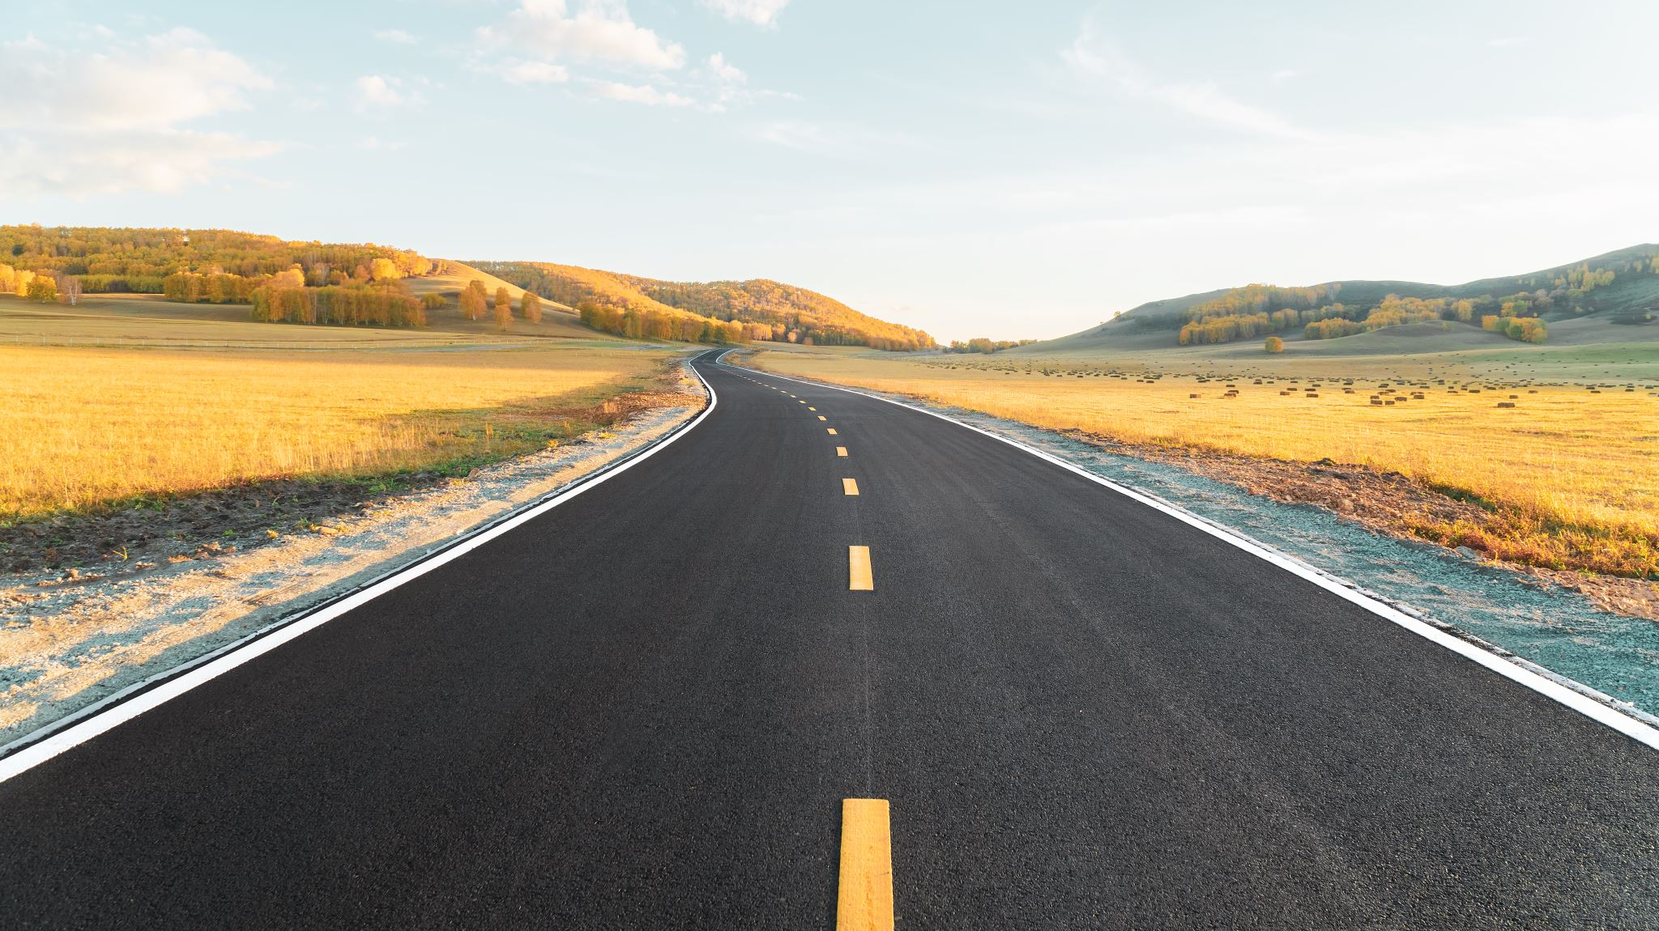
Results

Slide 16
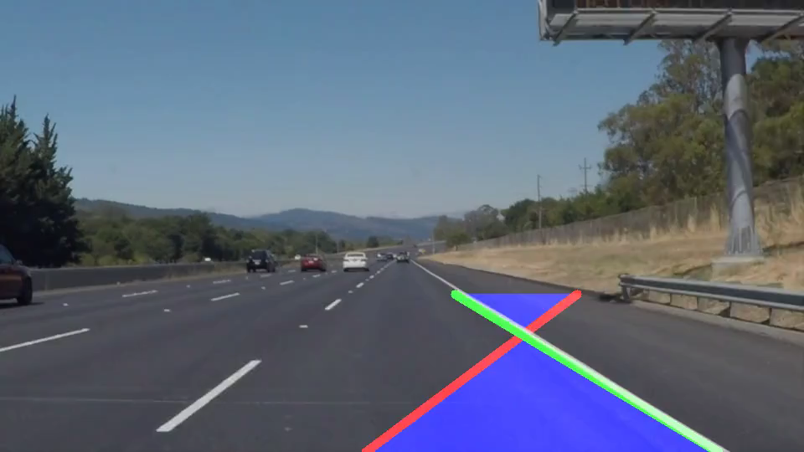
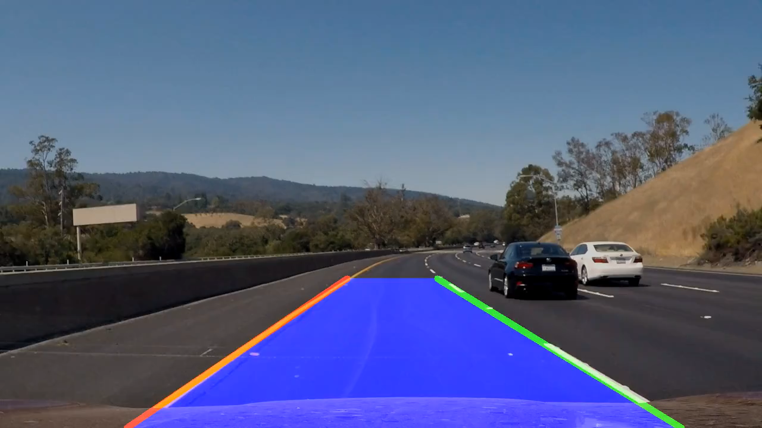
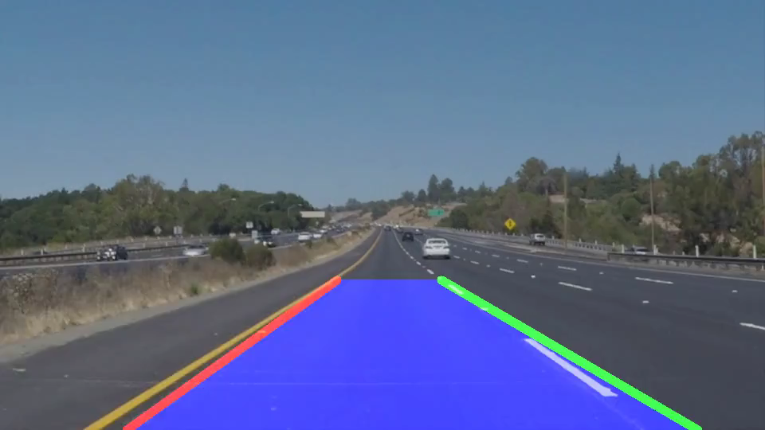

Slide 17
Conclusion
To create a lane detection system, we suggested novel lane detection pre-processing and ROI selection approaches.
The key concept is to include white extraction before the standard basic pre-processing.
To increase lane detection accuracy, edge extraction was implemented during the pre-processing step.
We also placed the ROI selection after the pre-processing suggested.
We now only used the Hough transform to find straight lanes and the EKF to track lanes.

Slide 18
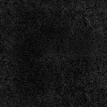
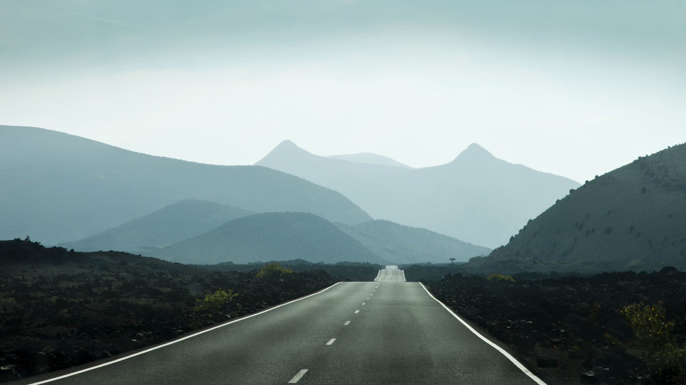
Thank you!

